Slide 1

Module 3: Individual Peacekeeping Personnel
Lesson
3.7
Personal Security Awareness

Slide 2

Relevance
As UN personnel, you are at substantial risk of being targeted
Your individual security depends on how well you are prepared
UN Core Pre-Deployment Training Materials 2017

Slide 3
Learning Outcomes
Learners will:
List the five principles of personal security
List examples of specific threats and explain the personal security measures that respond to each threat
List actions to take for your personal security
UN Core Pre-Deployment Training Materials 2017

Slide 4
Lesson Overview
Your Individual Responsibility
The Five Principles of Personal Security
Personal Security & Specific Threats
What Individual Peacekeeping Personnel Can Do
UN Core Pre-Deployment Training Materials 2017

Slide 5
Learning Activity
3.7.1
Threats to UN Peacekeeping Personnel
Instructions:
Recall the categories of threats to the UN
List threats to the personal security of UN personnel in the field
Time: 5 minutes
Brainstorming: 3 minutes
Discussion: 2 minutes
UN Core Pre-Deployment Training Materials 2017

Slide 6
1. Your Individual Responsibility
You are responsible and accountable for your own safety and security
You should develop a strong sense of security awareness
You must adjust your behaviour to take into account the environment in which you find yourself
UN Core Pre-Deployment Training Materials 2017

Slide 7
2. The Five Principles of Personal Security
Be aware
Avoid routine
Maintain your security procedures
Maintain good communications
Exercise initiative and common sense
UN Core Pre-Deployment Training Materials 2017

Slide 8
3. Personal Security & Specific Threats
Sexual violence, sexual assault
Arrest, detention
Hostage taking
Crowds, protests and demonstrations
Landmines, ERW and IEDs
Weapons firing
Hijacking
UN Core Pre-Deployment Training Materials 2017

Slide 9
Learning Activity
3.7.2
Personal Security and Specific Threats
Instructions:
Consider the examples of specific threats
What precautions would you take?
How should you respond in each situation?
Discuss the importance of awareness
Time: 15 minutes
Group work: 5-7 minutes
Discussion: 5 minutes
UN Core Pre-Deployment Training Materials 2017

Slide 10
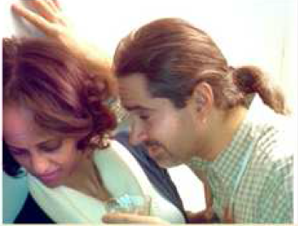
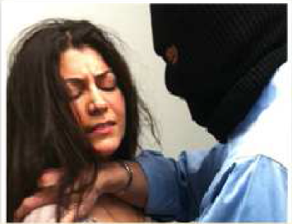
Sexual Violence, Sexual Assault
Be aware of effects of alcohol
Never leave drink unattended
Socialize in large groups
Be wary of strangers
Seek immediate assistance if drugged
Be aware while alone, especially when driving
Take precautions – meet in public, inform others
UN Core Pre-Deployment Training Materials 2017

Slide 11

Arrest, Detention
Insist on your rights as UN staff
Insist on communicating with your office
Answer questions truthfully
Do not write or sign anything until seen by a UN rep
If there are two of you not arrested, one to accompany, other to seek assistance
Immediately inform the Head of Office
UN Core Pre-Deployment Training Materials 2017

Slide 12
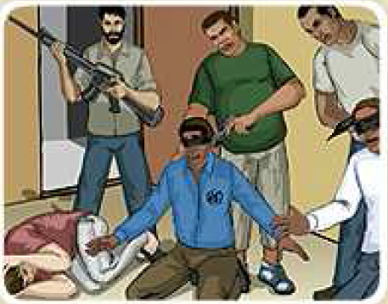
Hostage Taking
Do not fight back, make sudden moves
Keep calm, obey orders, a low profile
Do not speak unless spoken to
Try not to give up I.D. or clothes
Observe as much as possible
During rescue, immediately drop to floor
UN Core Pre-Deployment Training Materials 2017

Slide 13
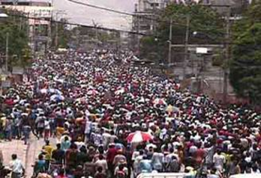
Crowds, Protests, Demonstrations
Do not panic
Leave the area as quickly as possible
Leave by the safest means possible
UN Core Pre-Deployment Training Materials 2017

Slide 14
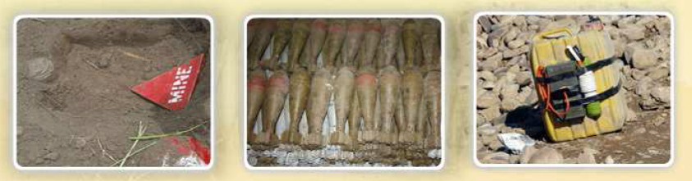
Landmines, ERW, IEDs
Landmines | Explosive Remnants of War (ERW) | Improvised Explosive Devices (IEDs)
Explosives or other materials, normally encased, designed to destroy, damage, wound or kill | Explosive devices left over from a conflict – grenades, rockets, mortars, artillery shells, bombs, cluster munitions and fuses | Explosive devices assembled by a user (rather than by a commercial factory)
UN Core Pre-Deployment Training Materials 2017

Slide 15
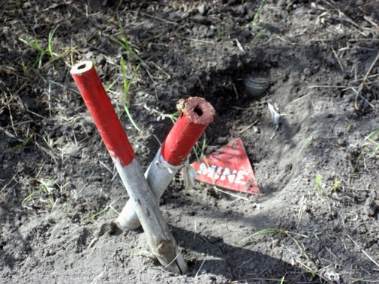
Landmines, ERW, IEDs
Movement stops immediately
Inform and warn people around you
Note the area
Evaluate the situation
Do not move from your position
UN Core Pre-Deployment Training Materials 2017

Slide 16
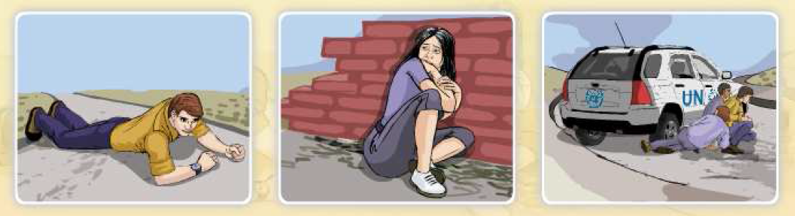
Weapons Firing
On foot
Drop down, hit the ground, crawl to the nearest cover if possible
In a vehicle
Accelerate, drive through if possible – otherwise exit, hide behind engine block, or crawl to better cover nearby
UN Core Pre-Deployment Training Materials 2017

Slide 17
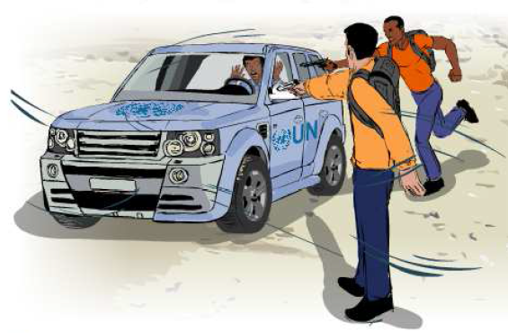
Hijacking
Precautions
Avoid travel in the evening, certain locations, alone
Be alert
Never set a driving pattern
Keep vehicle in good condition, locked
If you are stopped by hijackers
Do not resist, provoke, make sudden moves
Leave ignition running
Surrender personal items
UN Core Pre-Deployment Training Materials 2017

Slide 18
4. What Individual Peacekeeping Personnel Can Do
Understand Your Surroundings
Host Country
Political Factors
Economic Factors
Cultural Factors
Environmental Factors
UN Core Pre-Deployment Training Materials 2017

Slide 19
Stay Alert
What to Watch For? | Human Observation Reporting Tips | Vehicle Observation Reporting Tips
Suspicious individuals Suspicious vehicles Suspicious or unattended objects | Ethnicity Height Build Sex Age Weight | License plate number Body style/size/colour Make/model/year Any peculiarities Occupants
UN Core Pre-Deployment Training Materials 2017

Slide 20
Take Precautions
Prevention is the best policy
The best way to be safe and secure is to avoid trouble in the first place
UN Core Pre-Deployment Training Materials 2017

Slide 21
Be Prepared
timely accurate information will protect
forces of law and order
aggressor
personal security measures
UN Core Pre-Deployment Training Materials 2017

Slide 22
Respond to Threats
If you find yourself in a situation of intense agitation, hostility and danger:
Stay calm
Do not be provoked
Take the action that preserves human life, health and dignity – in that order
Note: There are conflicting opinions regarding self-defense and the use of weapons
UN Core Pre-Deployment Training Materials 2017

Slide 23
Respond to Threats
After any serious incident:
Go to a safe place
Inform your security officer or Head of Office
Report the incident quickly and accurately
Professional counseling can be arranged
Seek medical assistance
Call a friend or close colleague

Slide 24
Summary of Key Messages
Principles of personal security – be aware, avoid routine, maintain security procedures, good communication, use initiative and common sense
Specific threats – sexual violence, arrest, hostage taking, crowds, explosive hazards, weapons firing, hijacking
Take action – understand surroundings, stay alert, take precautions, respond to threats
UN Core Pre-Deployment Training Materials 2017

Slide 25
Questions
UN Core Pre-Deployment Training Materials 2017

Slide 26
Learning Activity
Learning Evaluation
UN Core Pre-Deployment Training Materials 2017

